Slide 1

Introducing MESCAL
Modular Energy Scenario Comparison Analysis Library
Helge Esch

Slide 2
Agenda
MESCAL: A modular library and framework
StudyManager: A structured approach to dealing with multi-scenario studies
Dataset class: The ultimate modular class to combine, link, merge, concatenate, compare various Datasets
A unique relationship: Integrating Model DFs and Variable Time-Series DFs
Shared Repo Structure: Template Structure for a Shared Studies-Repo
And there’s so much more...

Slide 3
One Modular Library and Framework to Process and Analyze All Energy System Studies
MESCAL
PyPSA
PLEXOS
PSSE
Antares
BID3
PECD
ENTSO-e TP
...
mescal_pypsa
mescal_plexos
mescal_psse
mescal_antares
mescal_bid3
mescal_pecd
mescal_etp
mescal_ABC
*
Custom or study specific data
MESCAL Datasets
study-specifc CustomDataModule
Database
study-specific DataLogic
DataBase
study-specific VariableCalculation
StudyManager
KPI
Dataset
KPICollection
DatasetCollections
FlagIndex
DatasetComparison
utils
mescal: Modular Library and Framework
Exploratory analysis / scripting
Structured data pipelines
Visualization (e.g. plotly / folium)
GUI App
Structured KPI extraction
Reports
...
*Each platform-interface is a separate package that implements the abstract classes from the generic mescal package.

Slide 4
Multi-Scenario Data Fetching with the StudyManager
StudyManager class
1) StudyManager setup
2) Fetching DFs from Datasets for flag = ‘ST.BiddingZone.MarketPrice’
study = StudyManager(...)
2.1 Fetch DF for all scenarios (MultiIndex)
study.scen.fetch(flag)
2.2 Fetch DF for single scenario
study.scen.get_dataset(‘base’).fetch(flag)
Scenarios
 | base |  | ... | Scen n
 | BZ A | BZ B | … | BZ X
00:00 | 2.2 | 5.0 | ... | 1.2
01:00 | 2.5 | 5.1 | ... | 1.3
02:00 | 2.4 | 5.0 | ... | 1.4
... | ... | ... | ... | ...
 | BZ A | BZ B | … | BZ X
00:00 | 2.2 | 5.0 | ... | 1.0
01:00 | 2.5 | 5.1 | ... | 1.0
02:00 | 2.4 | 5.0 | ... | 1.0
... | ... | ... | ... | ...
base
Scen 1
Scen n
StudyManager
2.3 Fetch DF for all comparisons (MultiIndex)
study.comp.fetch(flag)
2.4 Fetch DF for single comparison
study.comp.get_dataset(‘1 vs base’).fetch(flag)
Scenario Comparisons
 | 1 vs base |  | ... | n vs base
 | BZ A | BZ B | … | BZ X
00:00 | +0.2 | -0.3 | ... | +2.1
01:00 | +0.2 | -0.5 | ... | +2.1
02:00 | +0.1 | -0.2 | ... | +2.2
... | ... | ... | ... | ...
 | BZ A | BZ B | … | BZ X
00:00 | +0.2 | -0.3 | ... | +0.0
01:00 | +0.2 | -0.5 | ... | +0.1
02:00 | +0.1 | -0.2 | ... | +0.0
... | ... | ... | ... | ...
1 vs base
2 vs base
n vs base
Datasets
→ All provide the same functionality.

Slide 5
Everything is a Dataset! MESCAL’s ultimate modular class to handle data
Dataset class
1) Dataset class and its primary methods
2) Collections of Datasets and key underlying logic
class Dataset(ABC): def __init__( name: str = None, attributes: Dict = None, parent_dataset: Dataset = None, flag_index: FlagIndex = None, database: Database = None, )
@abstractmethod def accepted_flags() -> set[Flagtype]
@flag_must_be_accepted def fetch(flag: Flagtype, **kwargs) -> pd.DataFrame | pd.Series
def add_kpi(kpi: Union[KPI, KPIFactory])
def get_kpi_collection() -> KPICollection
...
class DatasetCollection(Dataset, ABC):
"""Abstract class to collect multiple Dataset instances
and handle them according to a specific logic.
Inherits all methods / functionalities from Dataset."""
class DatasetLinkCollection(DatasetCollection):
"""Links multiple Dataset instances so that: - the parent-Dataset accepts flags of all child-Datasets and automatically the data from the child-Dataset one that accepts the flag. - the child-Dataset instances have access to the parent-Dataset so that they can fetch from other, e.g. child_ds.parent_dataset.fetch(...)."""
class DatasetMergeCollection(DatasetCollection):
""”Fetch method will merge fragmented Datasets for same flag, e.g.:
- fragmented simulation runs, e.g. CW1, CW2, CW3, CWn.
- fragmented data sources, e.g. mapping from Excel file
with model from simulation platform."""
class DatasetConcatCollection(DatasetCollection):
""”Fetch method will return a concatenation of all child-Datasets
with an additional Index-level."""
class DatasetComparison(DatasetCollection):
""”Takes two Datasets (variation and reference) and fetch method will return the delta between the two (var-ref)."""
*For readability purposes, all self attributes are removed from dummy code.
→ Fully modular: All collection-types can be combined / nested with each other.
0%
5%
10%
20%
40%

Slide 6
Two DataFrame Formats with a Unique Purpuse: Integrating Model DFs and Variable Time-Series DFs
Model df <-> Variable time-series
Model df: Static attributes, properties and memberships per object: e.g. ‘Generator.Model’
A model df describes all objects of a specific object class: e.g. generators, bidding zones, lines, …
Quick builtin filter and groupby_agg operations thanks to implicit integration between variable time-series and model df: e.g. filter DE; groupby tech & control_area; sum.
Properties can come from various sources or custom internal logic: e.g. Plexos model + Excel Mapping + geojson; even study specific.
Model df should always be exhaustive and contain all properties.
Automatic preservation / mapping of nested properties: e.g. If line has node_from and node_to, and nodes have a BZ, then the Line.Model will also have BZ_from, and so on...)
Variable time-series can be simulation inputs, simulation outputs or custom variable calculations. They can come from various sources.
Variable time-series can be in / switch between DatetimeIndex, session_id+period, MTU enumeration, ..., allowing you to compare different time periods against each other (e.g. Climate years; months, ...).
 | tech | max_cap | is_intermittent_res | lat_lon | BZ | ...
Gen 1 | Wind | 100 | True | (45, 15) | DE_LU | ...
Gen 2 | RoR | 250 | False | (35, 10) | AT | ...
... | ... | ... | ... | ... | ... | ...
Gen n | PV | 300 | True | (25, -5) | ES | ...
o
Variable time-series df: time-series per object e.g. ‘ST.Generator.Generation’
 | Gen 1 | Gen 2 | … | Gen n
00:00 | 2.2 | 5.0 | ... | 0.0
01:00 | 2.5 | 5.1 | ... | 0.0
02:00 | 2.4 | 5.0 | ... | 0.0
... | ... | ... | ... | ...

Slide 7
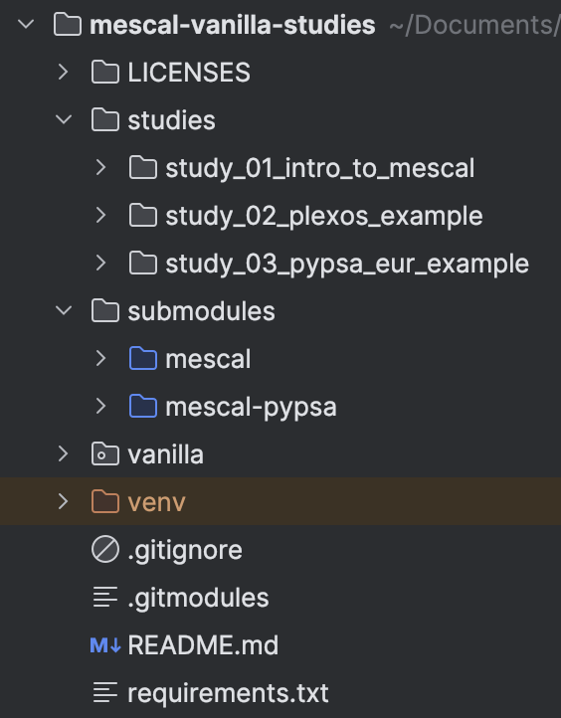
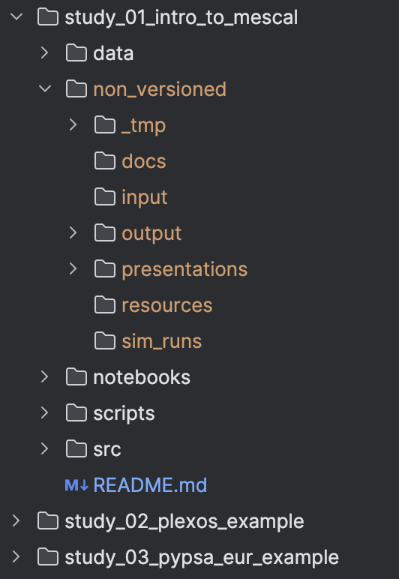
Template Structure for a Shared Studies-Repo
Shared repo structure
Generic vs study-specific code / data in a shared repository
Shared vs private code / data in a shared repository
Shared data
Study specific code & data
Private (local) code / data
Generic packages & modules
Utils
Shared code
*Example repository structure. Repo does not exist (yet).

Slide 8
And there’s so much more
KPI package for complex comparison KPIs (e.g. PercentageIncrease, ...)
Plotly integration for interactive graphs
On-demand or pre-load data conversion / computation
Will be open source
Folium integration for interactive HTML-maps
Optional DataBase integration
Time-series index conversion setting
DatetimeIndex <-> Session, Period <-> MTU enumeration
MESCAL
TimeSeriesDashboard
TypeHints everywhere → IDE type checking
Searchable and filterable HTML KPI tables
Fully object-oriented
Follows Clean Code (c.f. Robert C. Martin)
Identify geo projection points / angles for shape borders for physical (touching) borders as well as non-physical borders (divided by water).
Segmented linear colormaps
Interpolate missing geo-coordinates based on topology

Slide 9
APPENDIX

Slide 10
High level overview of the KPI package
KPI package
1) KPI class
2) Aggregations & Comparisons
3) KPICollection class
class KPI(ABC): def __init__(dataset: DatasetType) def name() -> str def value() -> int | float | bool def compute() def unit() -> Units.Unit def get_pretty_text_value(
decimals: int = None, order_of_magnitude: int = None, include_unit: bool = None ) -> str:
class FlagAggKPI(KPI): def __init__( dataset: DatasetType, aggregation: Aggregation, flag: Flagtype = None, subset: Hashable | list[Hashable]] = None, model_query: str = None, )
class ComparisonKPI(KPI): def __init__(
variation_kpi: KPI,
reference_kpi: KPI,
Comparison: ValueComparison,
)
class Aggregations:
Total Sum Max Mean Min AbsSum AbsMax AbsMean AbsMin SumGeqZero SumLeqZero MeanGeqZero MeanLeqZero MTUsWithNaN MTUsNonZero MTUsEqZero MTUsAboveZero MTUsBelowZero
...
CustomAggregation
class ValueComparisons: Increase Decrease PercentageIncrease PercentageDecrease Share Delta Diff
class KPICollection
"""Class to hold a set of KPIs, e.g. for a Dataset.
Contains methods to add or retrieve KPIs in various formats,
e.g. as pd.Series.""”
class KPIGroup(KPICollection)
"""Class to hold a group of KPIs. A “group” of KPIs has something in
commong, e.g. they all belong to the same object,
or they all belong to the same object class, etc."""
class KPIGrouper(KPICollection)
"""Class to group KPIs by specific commonalities,
e.g. KPIs that all belong to the same object,
or they all belong KPIs to the same object class, etc."""

Slide 11
FlagIndex and Mapping Units
FlagIndex class
class; methods

Slide 12
Key Principles of Clean Code (Robert C. Martin)
Meaningful Names: Descriptive, intention-revealing names. Avoid abbreviations or misleading terms.
Small Functions: Functions should do one thing and be small. Limit arguments (0-2).
DRY (Don’t Repeat Yourself): Eliminate duplication. Abstract common behaviors.
Single Responsibility Principle (SRP): Each class/function should have one responsibility, one reason to change.
Open/Closed Principle (OCP): Code should be open for extension, closed for modification.
Avoid Side Effects: Functions should not have unexpected behavior or change the program’s state unpredictably.
Exceptions Over Error Codes: Use exceptions for error handling, not return codes.
Command-Query Separation: Functions should either perform an action (command) or answer a question (query).
Encapsulation: Hide internal details, exposing only what’s necessary.
Readable Code: Favor readability. Consistent formatting and self-documenting code minimize comments.
Minimize Comments: Use comments only to explain complex logic or decisions, not how the code works.
Unit Testing: Code should be easy to test in isolation. Automate tests to ensure functionality.
Separation of Concerns: Divide code into modules, each handling a distinct concern.
Avoid Premature Optimization: Focus on clarity first, optimize only when necessary.
Consistent Naming: Stick to agreed naming conventions (camelCase, PascalCase, snake_case).

